Slide 1



Slide 2
2025
Impact
Report
Notes:
Good afternoon and I'm delighted to share some highlights of our work this year.

Slide 3

INVEST
GROW
TALENT
ENGAGE
We attract new investment and jobs into the city.
We foster scale-up activity and long-term growth of existing London businesses.
We connect employers to talent and develop a skilled workforce to meet future needs.
We champion positive economic dialogue locally, nationally and internationally.
WHAT WE DO
Notes:
As you know, LEDC contributes to the growth of our economy through new investment attraction, retention and growth of local companies, workforce development and business engagement.
These functions are guided by detailed strategies such as providing access to capital, space, talent, training etc. and measured by key performance indicators.

Slide 4

KEY SECTORS
DIGITAL MEDIA & TECH
AGRI-FOOD
MANUFACTURING
HEALTH
7,500+ employed
120+ companies
38,000+ employed
500+ companies
25,000+ employed
100+ companies
16,100+ employed
400+ companies
Notes:
Our work focuses on developing industry clusters that generate the highest economic activity in the region.
These clusters not only create direct jobs and investments, but also drive spin off economic activity through supply chains, construction, retail, hospitality and more.
We have referral mechanisms in place, so that companies outside of these sectors are also supported by other local agencies.

Slide 5
ANNUAL
METRICS
ANNUAL
EXPANSIONS &
ATTRACTIONS
JOBS ADDED
20
25
$ 137 M
1,060
20
24
$ 190 M
1,100
ANNUAL
Notes:
So far this year LEDC has facilitated close to $228 million in expansions and attractions. Companies making these investments have reported over 800 jobs being added this year to London’s workforce.
Please note that these figures DO NOT include the major regional investment with VW/Powerco in the St.Thomas EV Battery Plant. While LEDC played a key role in attracting VW to the region, we only report jobs and investments made in the City.

Slide 6
SINCE
INCEPTION
FACILITATED CREATION OF NEW JOBS
NEW INVESTMENT
ANNUAL PROPERTY TAX
28 K +
$3.6 B +
$ 28 M +

Slide 7
ACCELERATE
ANNUAL
RETENTION
FILES
JOBS
RETAINED
ACTIVE EXPANSION FILES
COMPANIES WORKED WITH
20
25
4
382
24
380
20
24
5
233
15
530
ANNUAL
Notes:
The Invest portfolio seeks to attract new investments, while Accelerate portfolio helps established companies scale up and grow.
We do this by connecting companies to infrastructure, funding sources, regulatory and permitting processes, R&D and assistance with talent recruitment.
This year, we saw major growth in automation, advanced manufacturing and food processing sectors. We also keep a pulse on companies that may be at risk due to trade issues, lost contracts or changes in their industry. Our pipeline of active attraction and expansion files was healthy as companies continued to invest in industrial lands, automation, upskilling and diversification.

Slide 8
INVEST
ANNUAL
INVEST
MISSIONS
ATTRACTION
FILES
FDI
PROPOSALS
SITE SELECTION /
VIRTUAL TOURS
20
25
13
6
82
100
20
24
17
15
93
144
ANNUAL

Slide 9



























COMPANIES WE’VE
WORKED WITH

Slide 10




RECENT
INVESTMENTS
Innofoods
VOLKSWAGEN
CARFAX CANADA
WSIB ONTARIO
Innofoods, a healthy snack food manufacturer, has chosen London for its first expansion outside B.C., building a facility at Innovation Park that will initially create up to 90 jobs, with plans to double its workforce in the next phase
Volkswagen Gigafactory in St. Thomas, Ontario is expected to employ up to 3,000 people and create thousands of spinoff jobs. Volkswagen is investing $7 billion to build the plant.
CARFAX Canada's growth in London has been significant. What started as a small startup has evolved into a leader in the tech industry, employing over 500 people, also making it one of the largest tech employers in the region.
LEDC supported the WSIB head office attraction to bring hundreds of well-paying technology, innovation and knowledge economy jobs to the London region.
Notes:
New jobs and investments in food processing, life sciences, and advanced manufacturing have helped further diversify our economy, and helped us withstand the economic slowdown and rising interest rates.
Maple Armor a international business producing fire alarm systems for both commercial and consumers is 14 acres in Innovation Park for the construction of a 150,000 square foot manufacturing facility where they would consolidate Canadian manufacturing and R&D. The project would create 50 immediate jobs with a full build vision of 200.

Slide 11









WORKFORCE
DEVELOPMENT
ANNUAL
EXTERNAL
JOB FAIRS
EMPLOYER & JOB SEEKERS CONSULTATION
WORKFORCE
PROJECTS
TALENT
PRESENTATIONS
20
25
10
5,440
18
22
20
24
7
3,720
10
26
ANNUAL
Notes:
Access to talent continues to be a major constraint as our region is projecting a need for 40,000 workers over the next 7 years.
We continued to assist employers with their hiring needs, through major job fairs, newcomer attraction and post-secondary partnerships.
8 External Job Fairs:
WILL Employment Advanced Manufacturing Job Fair (130)
WILL Employment Health Job Fair (20)
UWO (2) (400X2)
Fanshawe (1000X2)
Northwest London Resource Centre (21)

Slide 12
JOB PORTALS
USERS
PAGE VIEWS
AVG. # OF COMPANIES
AVG. # OF JOB TITLES
80,300+
666,900+
101
13,050+
londonmfgjobs.com
95,300+
647,000+
91
14,150+
londontechjobs.com
59,000+
186,700+
31
7,090+
londonhealthjobs.com
Notes:
This year we have been working together with to Bamboo Innovations Inc. and on the Job Portals automation and built an advanced AI model using machine learning algorithms to scan websites (Career pages), pick up any new job postings, adjust them to fit LEDC’s standard format and add them to the LEDC job board every 24 hours.
29 Companies on Automated Job portals Phase II starting soon
Pageviews on all 3 job portals have increased significantly from last year:
LMJ from 143,700 to 382,000 – 165%
LTJ from 137,900 to 395,800 – 187%
LHJ from 15,200 to 68,133 -348%
WHY:
MK Campaigns (AI - emails replying to inquiries from DTT and Choose London)
Social media on Facebook and LinkedIn
New banners with QR code
Job Portals (New Jobs alert subscriptions)

Slide 13
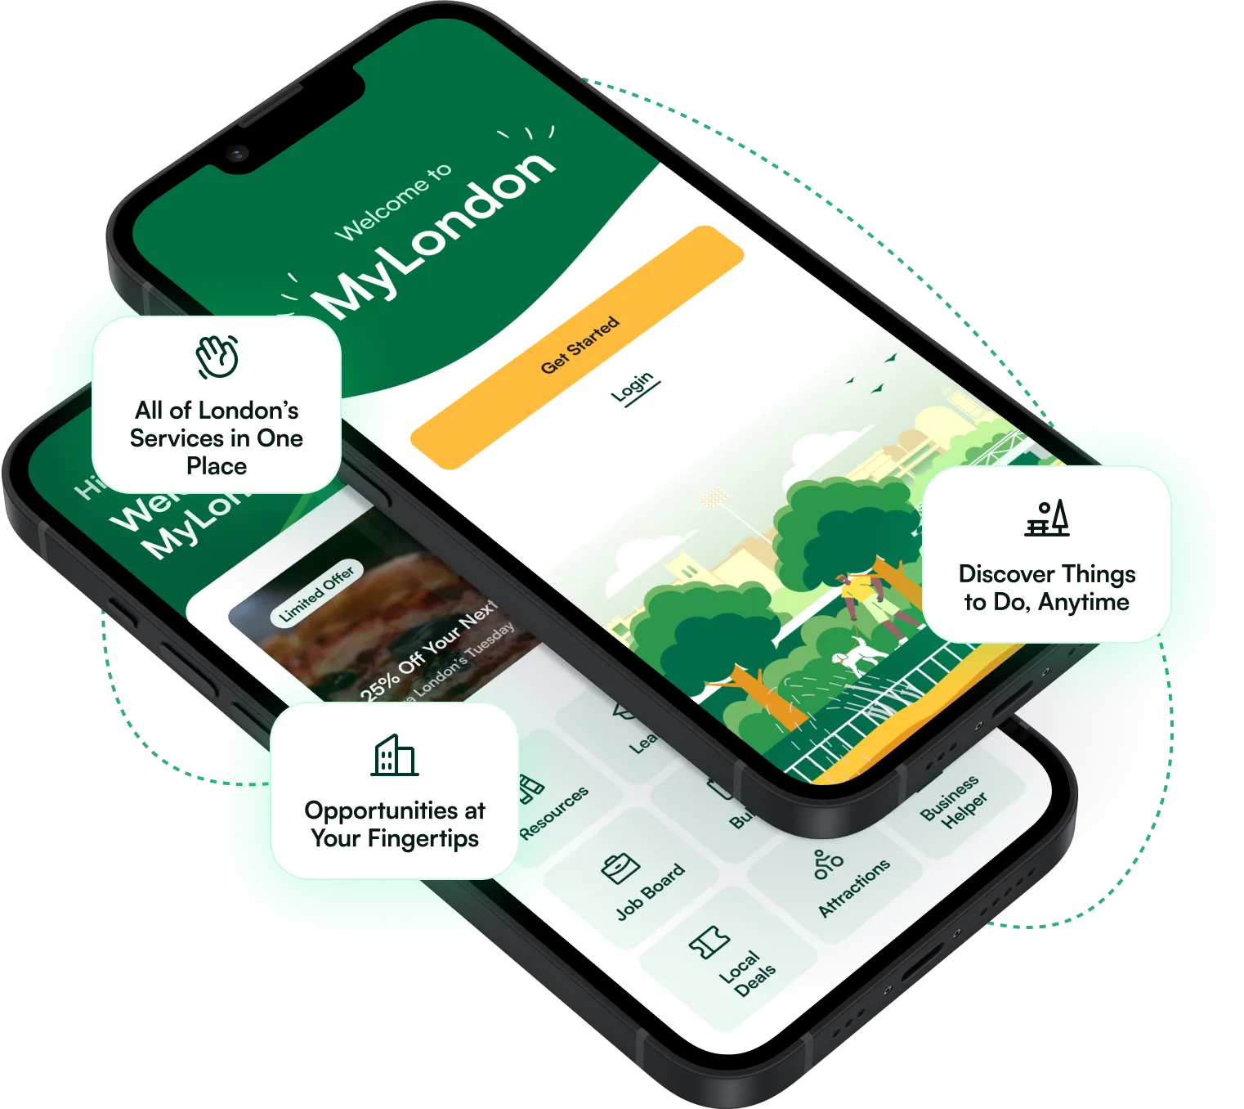

MARKETING
CAMPAIGNS
DON’T TELL
TORONTO
CHOOSE
LONDON
LOVE LONDON
CANADA
MyLondon
APP
Campaign targeted in the GTA to attract experienced and skilled talent to help fill London’s growing industries of health, manufacturing & tech.
Campaign to capitalize on and attract the disenfranchised talent in the U.S.A.
This quirky series shines a light on the people, ideas, and moments that make this city quietly exceptional, reminding Londoners why they’re proud to call it home, and showing everyone else that what they already know… came from London.
Helps newcomers, students, visitors, and residents navigate life in London by bringing jobs, services, and local opportunities into one place. Developed in partnership with Tourism London, Welcome Platform, Western University, and Fanshawe College, it’s a first-of-its-kind platform.

Slide 14



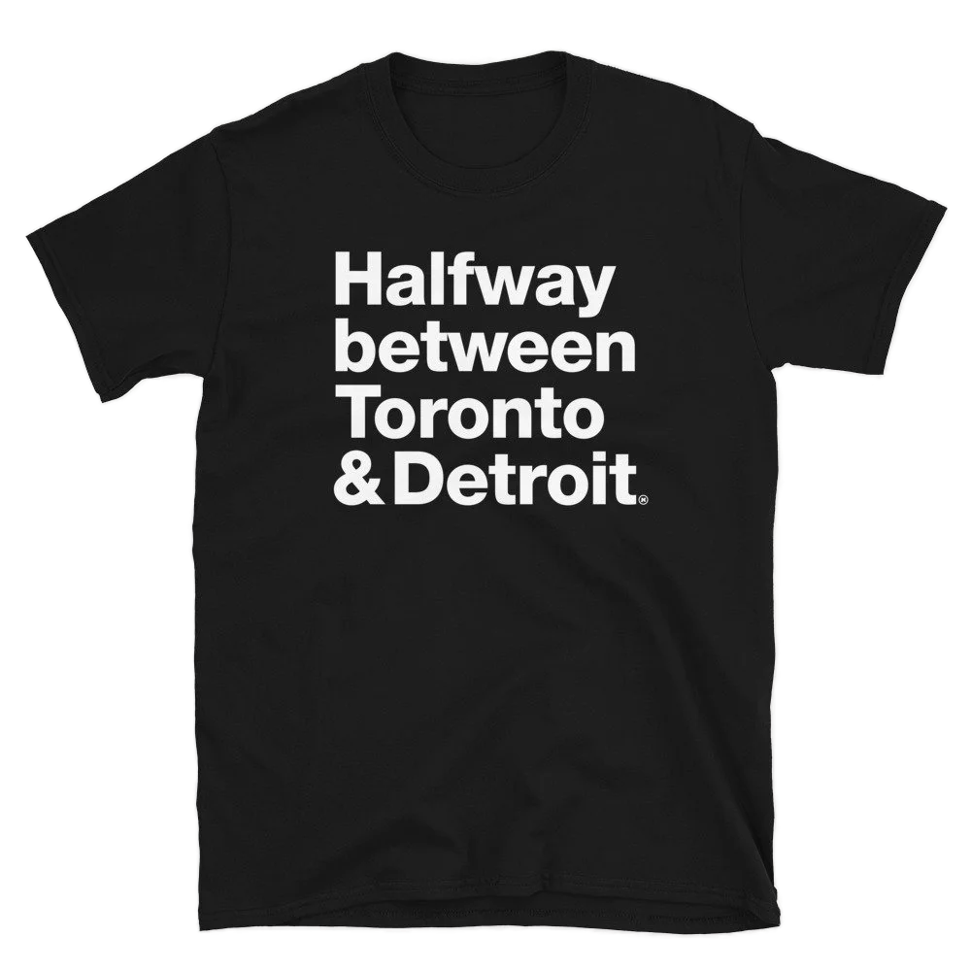



TRANSATLANTIC
EV TRIANGLE
DOCTOR RECRUITMENT
HALF WAY BETWEEN
LEDC REBRAND
An initiative to link the electric mobility ecosystems of Canada, Germany, and Spain, to facilitate the exchange of supply-chain related talent, direct investment, and R&D capabilities.
We believe everyone in our city deserves access to exceptional primary healthcare. That’s why LEDC is proud to support efforts to recruit talented family physicians to London, Ontario.
As a Londoner where —exactly’ish — are you’re from? Our hope is this shirt will make that conversation easier. We are happy to partner with James Kingsley to promote this unexpected campaign.
The old branding wasn’t wrong—it served us well for 27 years—but it wasn’t right anymore. It didn’t reflect an organization focused on growth and investment and it was difficult to apply consistently. The new mark is bold, memorable and, like LEDC, ready for what comes next.
more
MARKETING
CAMPAIGNS

Slide 15
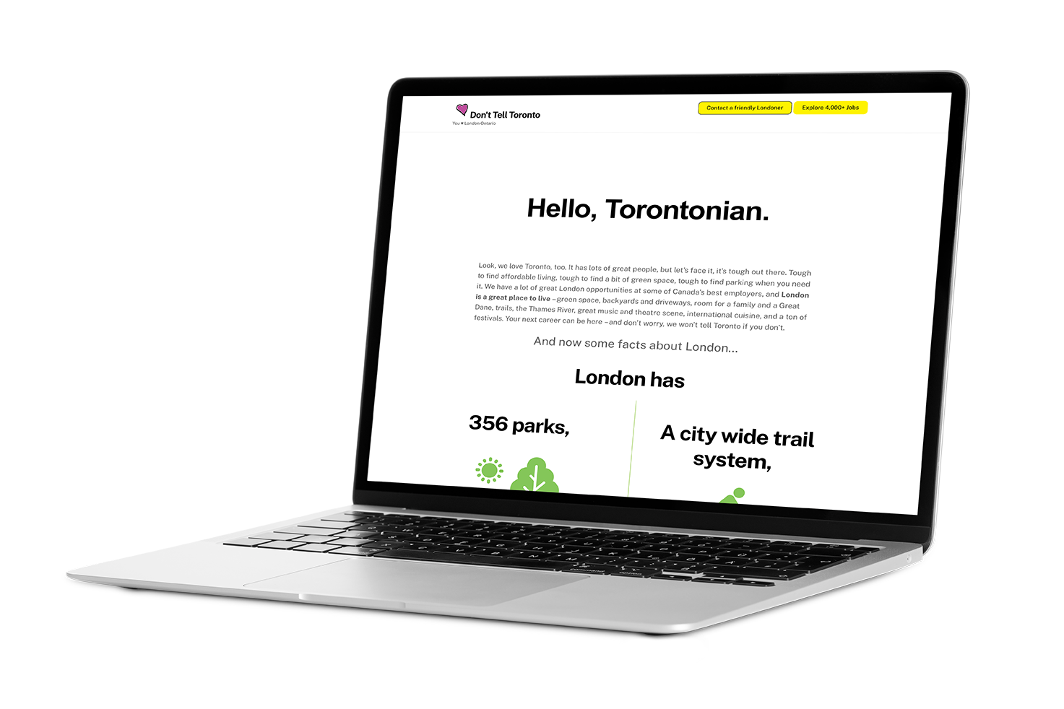
DON’T TELL TORONTO: THE NUMBERS
Total IMPRESSIONS 2025
Launched in February 2021, to attract experienced and skilled talent to help fill London’s growing industry of health and technology.
11,248,627
ANNUAL
20
25
DIRECT CONTACTS
NEWSLETTER
SUBSCRIBES
3,071
10,638
20
24
4,841
8,961
ANNUAL

Slide 16
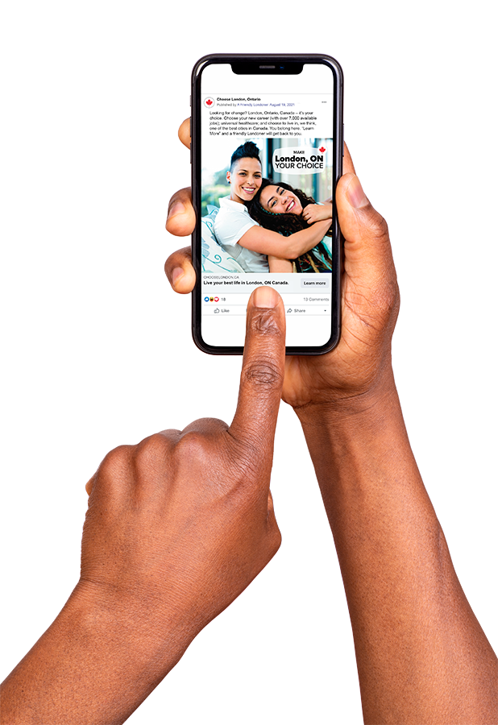
CHOOSE LONDON: THE NUMBERS
Total IMPRESSIONS 2025
US Campaign for London Economic Development to attract talent.
4,527,116
ANNUAL
20
25
DIRECT CONTACTS
NEWSLETTER SUBSCRIBES
11,386
17,385
20
24
5,213
6,959
ANNUAL

Slide 17

IMPRESSIONS
Need content for this.
4,986,980
LOVE LONDON CANADA
Total IMPRESSIONS 2025
Initiated in June, 2025.
Because London’s impact is bigger than its reputation. This quirky, honest series shines a light on the people, ideas, and moments that make this city quietly exceptional, reminding Londoners why they’re proud to call it home, and showing everyone else that what they already know… came from London.
4,986,980
ANNUAL
20
25
PLAYLIST VIEWS
800,206
20
24
5,213
6,959
ANNUAL

Slide 18
MyLondon APP
Initiated August, 2025
MyLondon app helps newcomers, students, visitors, and residents navigate life in London by bringing jobs, services, and local opportunities into one place. Developed in partnership with Tourism London, Welcome Platform, Western University, and Fanshawe College, it’s a first-of-its-kind platform.
ANNUAL
20
25
DOWNLOADS TOTAL
REGISTRATIONS
4,175
2,162
JOB LISTING VIEWS
JOBS RECOMMENDED
“APPLY NOW”
CLICKS
1,411
3,629
140
20
24
5,213
6,959
ANNUAL

Slide 19
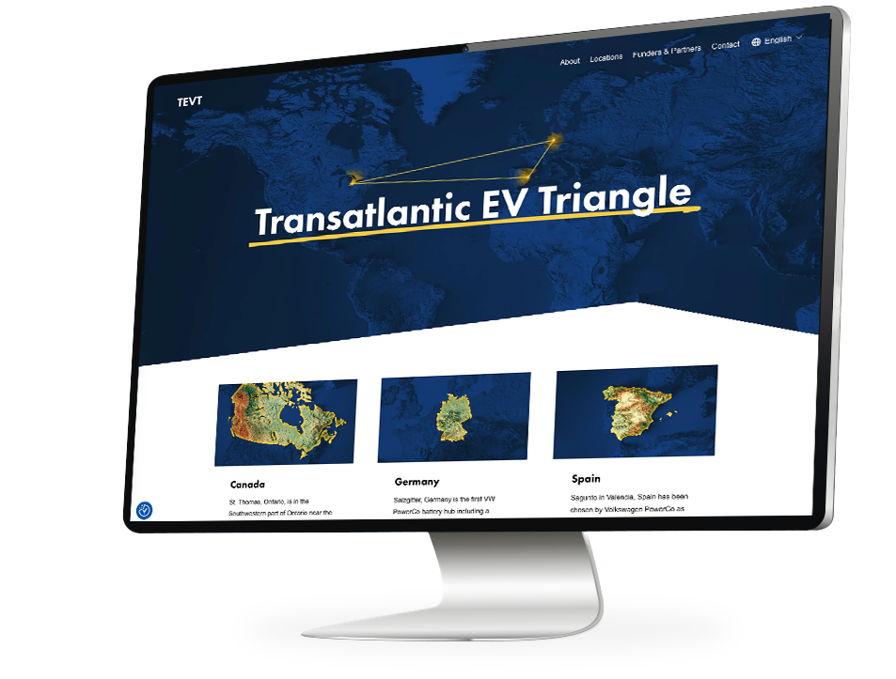
TEVT
Initiated August, 2025
An initiative to link the electric mobility ecosystems of Canada, Germany, and Spain, to facilitate the exchange of supply-chain related talent, direct investment, and R&D capabilities.
ANNUAL
20
25
SITE VISITS
AVG. TIME ON SITE
1,853
00:01:59
JOB LISTING VIEWS
JOBS RECOMMENDED
“APPLY NOW”
CLICKS
1,411
3,629
140
20
24
5,213
6,959
ANNUAL

Slide 20






In partnership with Tourism London, 2026 will see the continuation of the London Film Incentive Program, designed to increase the number of productions filmed in London. London is the first city in Ontario to start an initiative like this.
Film productions accounted for $200,000 in hotel stays.
Film London created a new online database, with more robust features for talent acquisition.
Created 240 jobs, including Fanshawe & UWO grads
LONDON
FILM
In 2025, Film London supported 6 feature films shot entirely in London (a new record). These features generated over $1.1 million in revenue towards the local economy.
Film London supported the production of various other web series, tv series, and short films, including a pilot season for a Bell Fibe series.

Slide 21

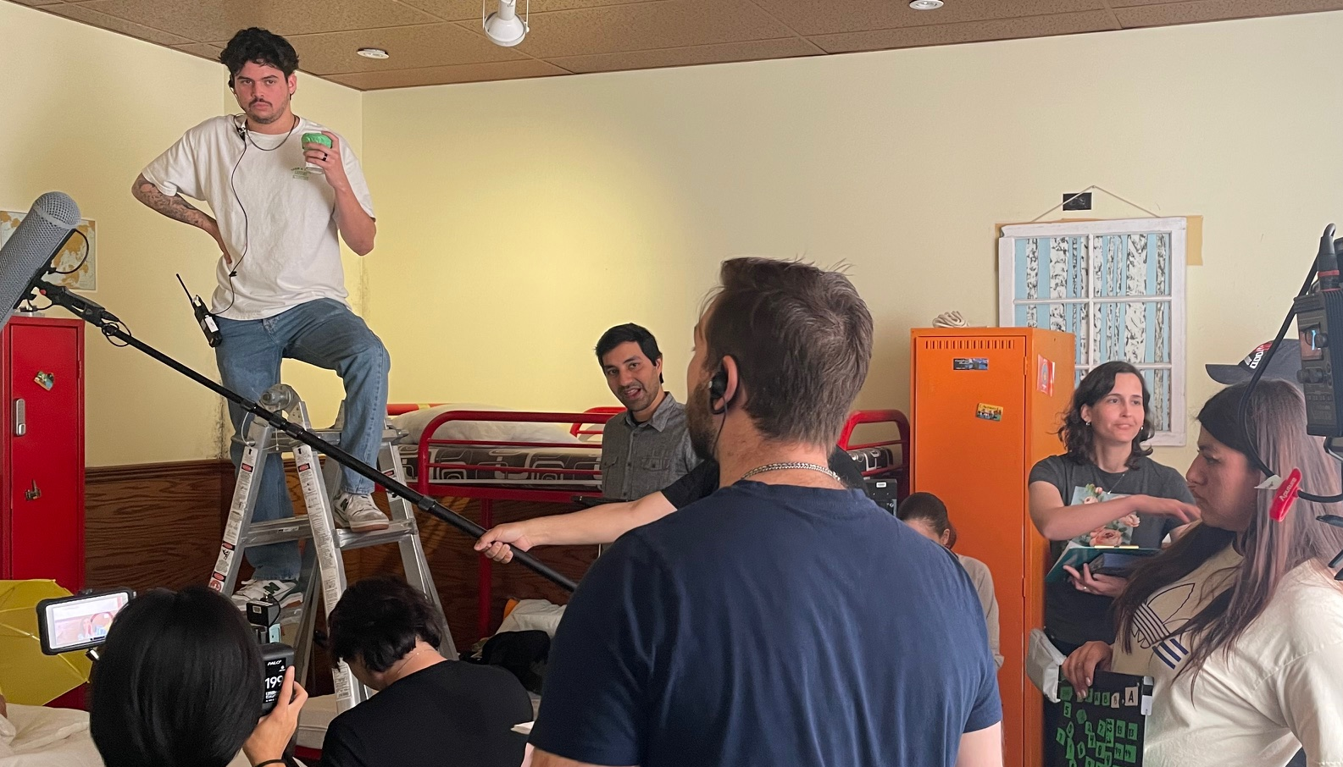

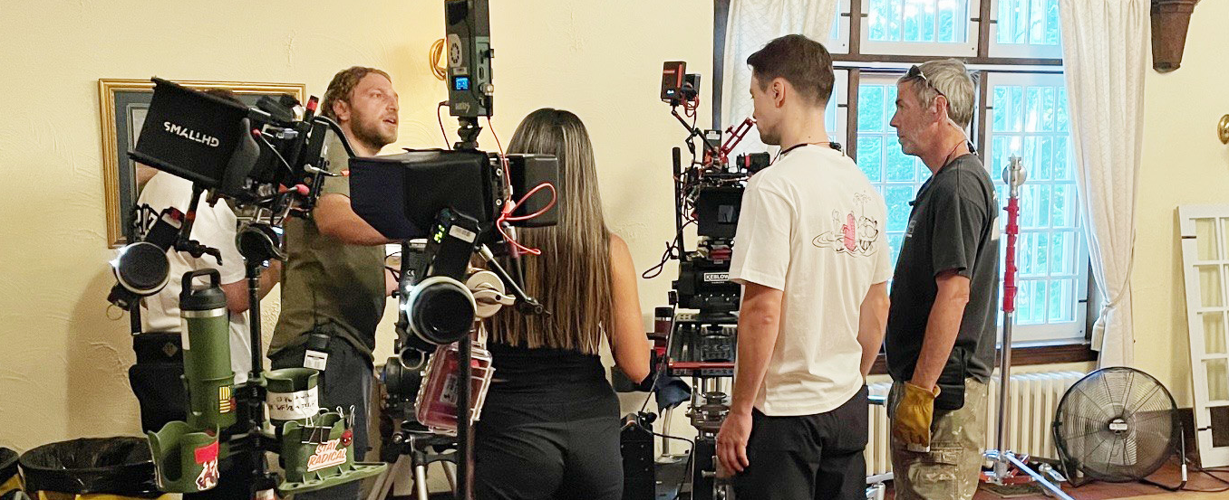


Slide 22





EVENTS
MANUFACTURING
MATTERS
TECH CENTRIC AI AND CYBERSECURITY
LONDON AND
AREA WORKS
WHERE TO FOCUS FORUM
LIFE SCIENCES LONDON
In partnership with London Region Manufacturing Council. A half day conference for manufacturers and service providers. Delegates discuss industry status and trends with peer-to-peer networking, workshops and talks from industry leaders.
A conference that covers everything from food processing to finance, healthcare to manufacturing, virtually every industry relies on technological advancements to streamline processes, enhance productivity, and unlock opportunities.
A community initiative to help employers highlight their open positions through a portal, weekly video series, and bi-annual job fairs.
WTF events are designed to bring founders, funders, and support organizations into the same room to cut through noise, share real insight, and focus on what actually moves businesses forward.
London’s strengths in Life Sciences are based on a foundation of highly regarded Academic and Clinical Research at Western University’s Schulich School of Medicine and Dentistry, Robarts Research Institute, and Lawson Health Research Institutes in partnership with London’s teaching hospitals, St. Joseph’s Health Care and London Health Sciences Centre.

Slide 23





EVENTS
APP LAUNCH
SOUTHWEST FOOD
INNOVATION SUMMIT
SCREENWRITERS
SERIES
LONDON CREATIVE MIXER
MADE IN LONDON
MyLondon app helps newcomers, students, visitors, and residents navigate life in London by bringing jobs, services, and local opportunities into one place. Developed in partnership with Tourism London, Welcome Platform, Western University, and Fanshawe College, it’s a first-of-its-kind platform.
In partnership with the Small Business Centre The Foodpreneur Advantage offers the Scale Up Program, designed specifically for Food & Beverage Manufacturers, Producers and Distribution businesses that demonstrate high growth potential.
Direction and community for screenwriters. The Screenwriters club meets every 3 weeks to share work, read the work of others and offer feedback. Writers can present ideas, discuss barriers and share their grand vision to inspire each other.
Web developers, gamers, designers, streamers, content creators, and digital innovators get together for connection, creativity, and community.
The kick-off event for the holiday season; featuring local flavour and innovation. LEDC & The Small Business Centre bringLondon’s leading food and beverage producers together – from craft brewers to world-class manufacturers, – they all come together for connection, pride, and festive cheer.

Slide 24
ECONOMIC
INDICATORS
Population as of
July 1, 2025
Population growth between
July 1, 2024 and July 1, 2025
633,002
6,127
1%
POPULATION
GROWTH
RATE
Source Statistics Canada
Frequency: Annual
Table: 17-10-0148-01
Release date: 2026-01-14

Slide 25
ECONOMIC
INDICATORS
SINGLE FAMILY
DETACHED
STANDARD
CONDOMINIUMS
AGGREGATE
London
$705,000
$377,500
$662,100
Royal LePage National House Price Composite in the Fourth Quarter of 2025

Slide 26
Source: City of London, February 18, 2026
BUILDING SERVICES REPORT
CITY OF LONDON
2023
Category | Permits | Value ($)
Residential | 2,177 | 706,036,959
Commercial | 343 | 170,787,786
Industrial | 72 | 135,205,948
Institutional | 201 | 191,023,417
Other | 798 | 10,639,968
Total | 3,591 | 1,213,694,078
2024
Category | Permits | Value ($)
Residential | 2,430 | 1,204,181,977
Commercial | 406 | 165,740,309
Industrial | 81 | 365,066,456
Institutional | 224 | 466,119,117
Other | 727 | 10,650,343
Total | 3,868 | 2,211,758,202
2025
Category | Permits | Value ($)
Residential | 2,236 | 1,836,119,215
Commercial | 408 | 187,840,796
Industrial | 65 | 181,619,408
Institutional | 204 | 492,069,258
Other | 792 | 15,373,892
Total | 3,705 | 2,713,022,569

Slide 27

Thank you
Notes:
That’s it for my formal presentation. Thanks very much.

